Slide 1
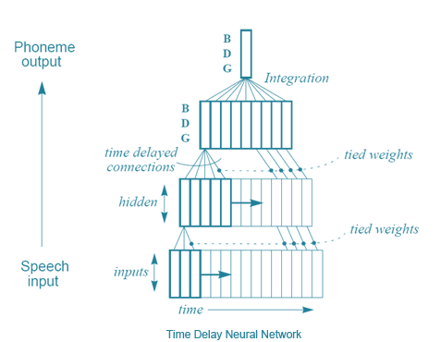
History
Alexander Waibel et. al (including Hinton) “Phoneme recognition using time-delay neural networks” 1989:
very similar to normal NNs
several sets of weights for different delays of the input
for an audio sequence, a moving window is input into the network
the same bits of audio processed by each neuron with different sets of weights
Source: https://electroviees.wordpress.com/tag/chacha/
Adapted from: andreykurenkov.com

Slide 2
History
Alexander Waibel et. al (including Hinton) “Phoneme recognition using time-delay neural networks” 1989.
TDNNs not successful in in speech recognition, surpassed by recurrent neural nets (RNNs).
But:
according to Hinton, the idea of TDNNs is what inspired LeCun to develop convolutional neural nets (CNNs), which became essential for image processing,
The main difference: no idea of time in a CNN, the windows move across the whole input image.
Source: https://electroviees.wordpress.com/tag/chacha/
Adapted from: andreykurenkov.com

Slide 3
VIDEO
https://www.youtube.com/watch?v=FwFduRA_L6Q

Slide 4

History
Yann LeCun et al. „Backpropagation Applied to Handwritten Zip Code Recognition” 1989.
A significant real-world application of backpropagation!
Adapted from: andreykurenkov.com
Notes:
AT&T Bell Labs
US Postal Service

Slide 5
History
„Classical work in visual pattern recognition has demonstrated the advantage of extracting local features and combining them to form higher order features. Such knowledge can be easily built into the network by forcing the hidden units to combine only local sources of information. Distinctive features of an object can appear at various location on the input image. Therefore it seems judicious to have a set of feature detectors that can detect a particular instance of a feature anywhere on the input place. Since the precise location of a feature is not relevant to the classification, we can afford to lose some position information in the process. Nevertheless, approximate position information must be preserved, to allow the next levels to detect higher order, more complex features (Fukushima 1980; Mozer 1987).”
Yann LeCun et al. „Backpropagation Applied to Handwritten Zip Code Recognition” 1989.
A significant real-world application of backpropagation!
Adapted from: andreykurenkov.com

Slide 6
History
„Classical work in visual pattern recognition has demonstrated the advantage of extracting local features and combining them to form higher order features. Such knowledge can be easily built into the network by forcing the hidden units to combine only local sources of information. Distinctive features of an object can appear at various location on the input image. Therefore it seems judicious to have a set of feature detectors that can detect a particular instance of a feature anywhere on the input place. Since the precise location of a feature is not relevant to the classification, we can afford to lose some position information in the process. Nevertheless, approximate position information must be preserved, to allow the next levels to detect higher order, more complex features (Fukushima 1980; Mozer 1987).”
Yann LeCun et al. „Backpropagation Applied to Handwritten Zip Code Recognition” 1989:
extracting local features
combining into higher order features
feature location irrelevant
preserve approximate position information
Adapted from: andreykurenkov.com

Slide 7
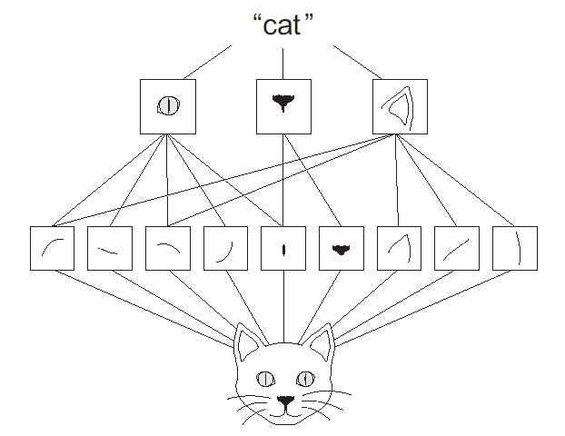
History
Yann LeCun et al. „Backpropagation Applied to Handwritten Zip Code Recognition” 1989:
extracting local features
combining into higher order features
feature location irrelevant
preserve approximate position information
Source: François Chollet, Deep learning with Python
Adapted from: andreykurenkov.com

Slide 8
History
Neuroscientific inspiration
Hubel & Wiesel (1981 Nobel Prize in Physiology or Medicine) „for their discoveries concerning information processing in the visual system.”
eye » retina » lateral geniculate nucleus » V1 » …
V1 (primary visual cortex):
is arranged in a spatial 2D map (feature maps)
contains simple cells ≈ a linear function of the image in a small, spatially localized receptive ﬁeld (detector units)
contains complex cells ≈ respond to features similar to those detected by simple cells, but invariant to small shifts (pooling units)
complex cells also invariant to some changes in lighting that cannot be captured simply by pooling over spatial locations (cross-channel pooling, e.g., maxout units)
Yann LeCun et al. „Backpropagation Applied to Handwritten Zip Code Recognition” 1989:
extracting local features
combining into higher order features
feature location irrelevant
preserve approximate position information
Adapted from: andreykurenkov.com
Notes:
1/4+1/4 nobel prize; research in the 60s

Slide 9
VIDEO
https://www.youtube.com/watch?v=IOHayh06LJ4
https://www.youtube.com/watch?v=8VdFf3egwfg

Slide 10
History
Neuroscientific inspiration
Hubel & Wiesel (1981 Nobel Prize in Physiology or Medicine) „for their discoveries concerning information processing in the visual system.”
eye » retina » lateral geniculate nucleus » V1 » » … (repeat: local features+detection+pooling) … » » V2 » V4 » inferotemporal cortex » » concept cells (e.g., „Jeniffer Aniston cell”) (Quiroga et al. 2005)
Differences:
small high-res patch+eye movements
integration with other senses
understand scenes (objects+relations)
feedback from higher levels
Intermediate computations? (activation, pooling, etc.)
Training?
Yann LeCun et al. „Backpropagation Applied to Handwritten Zip Code Recognition” 1989:
extracting local features
combining into higher order features
feature location irrelevant
preserve approximate position information
Notes:
100ms
Fovea+saccades

Slide 11
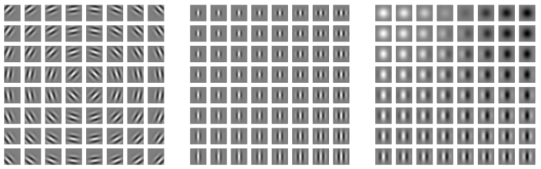
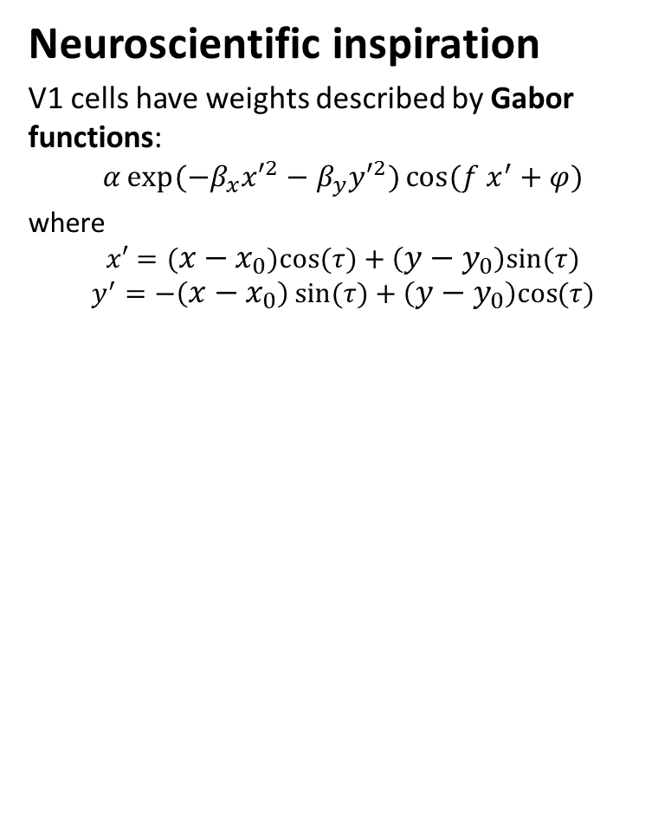
History
Neuroscientific inspiration
V1 cells have weights described by Gabor functions:
$$α\exp{(−β_{x}{x′}^{2}−β_{y}{y′}^{2})}\cos{(f x^{′}+φ)}$$
where
$$x′=({x−x}_{0})cos{(τ)}+\left({y−y}_{0}\right)sin{(τ)}$$
$$y^{′}=−\left({x−x}_{0}\right)\sin{(τ)}+\left({y−y}_{0}\right)cos{(τ)}$$
Yann LeCun et al. „Backpropagation Applied to Handwritten Zip Code Recognition” 1989:
extracting local features
combining into higher order features
feature location irrelevant
preserve approximate position information
Source: I Goodfellow, Y Bengio, A Courville, Deep Learning, 2016
Notes:
100ms
Fovea+saccades

Slide 12
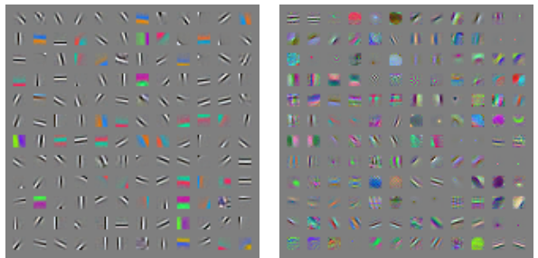
History
Neuroscientific inspiration
Edge detectors!
Yann LeCun et al. „Backpropagation Applied to Handwritten Zip Code Recognition” 1989:
extracting local features
combining into higher order features
feature location irrelevant
preserve approximate position information
Source: I Goodfellow, Y Bengio, A Courville, Deep Learning, 2016
Notes:
100ms
Fovea+saccades

Slide 13
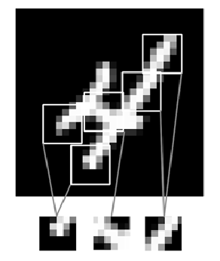
How to?
extract local features
combine them into higher order features
make feature location irrelevant
preserve approximate information on position
Source: François Chollet, Deep learning with Python

Slide 14
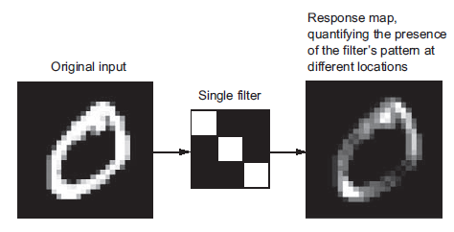
How to?
extract local features
combine them into higher order features
make feature location irrelevant
preserve approximate information on position
Source: François Chollet, Deep learning with Python

Slide 15
How to?
extract local features
combine them into higher order features
make feature location irrelevant
preserve approximate information on position
Source: François Chollet, Deep learning with Python

Slide 16
How to?
extract local features
combine them into higher order features
make feature location irrelevant
preserve approximate information on position
Source: François Chollet, Deep learning with Python

Slide 17
How to?
extract local features
combine them into higher order features
make feature location irrelevant
preserve approximate information on position
Source: François Chollet, Deep learning with Python

Slide 18
How to?
extract local features
combine them into higher order features
make feature location irrelevant
preserve approximate information on position
Source: François Chollet, Deep learning with Python

Slide 19
How to?
extract local features
combine them into higher order features
make feature location irrelevant
preserve approximate information on position
Source: François Chollet, Deep learning with Python

Slide 20
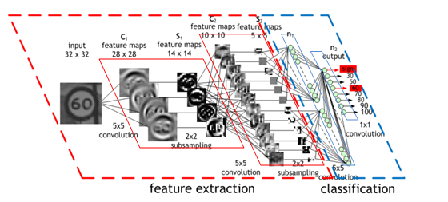
How to?
extract local features
combine them into higher order features
make feature location irrelevant
preserve approximate information on position
Source: https://sites.google.com/site/5kk73gpu2013/assignment/cnn
Notes:
filter/feature = kernel
feature map = convolution (of a given kernel)

Slide 21
How to?
Answer:
Replace matrix multiplication with convolution.
Everything else stays the same:
Maximum likelihood
Back-propagation
etc.
extract local features
combine them into higher order features
make feature location irrelevant
preserve approximate information on position
Source: https://sites.google.com/site/5kk73gpu2013/assignment/cnn
Notes:
filter/feature = kernel
feature map = convolution (of a given kernel)

Slide 22
How to?
Answer:
Replace matrix multiplication with convolution.
extract local features
combine them into higher order features
make feature location irrelevant
preserve approximate information on position
Everything else stays the same:
Maximum likelihood
Back-propagation
Notes:
filter/feature = kernel
feature map = convolution (of a given kernel)

Slide 23
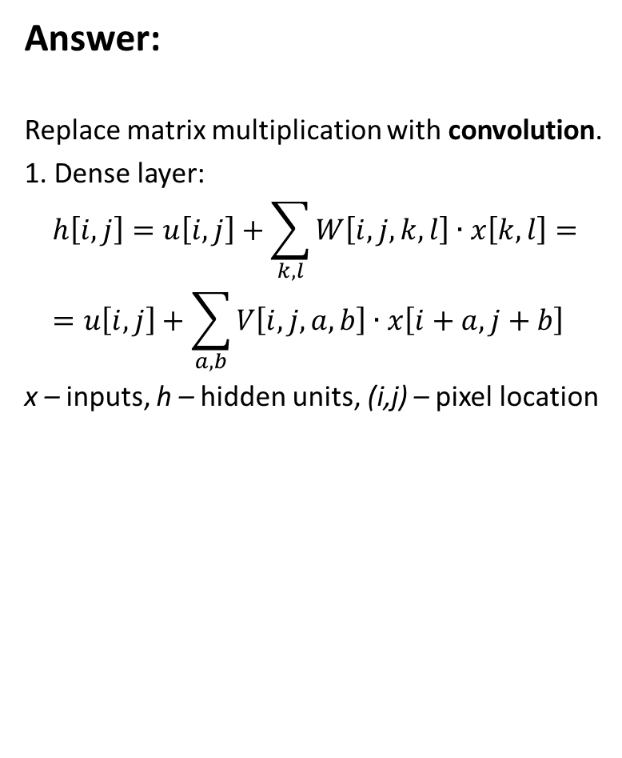
How to?
Answer:
Replace matrix multiplication with convolution.
1. Dense layer:
$$h\left[i,j\right]=u\left[i,j\right]+\sum_{k,l}{W\left[i,j,k,l\right]∙x\left[k,l\right]}= \\ =u\left[i,j\right]+\sum_{a,b}{V\left[i,j,a,b\right]∙x\left[i+a,j+b\right]}$$
x – inputs, h – hidden units, (i,j) – pixel location
extract local features
combine them into higher order features
make feature location irrelevant
preserve approximate information on position
Everything else stays the same:
Maximum likelihood
Back-propagation
etc.
Notes:
That’s for multilayer perceptron.

Slide 24
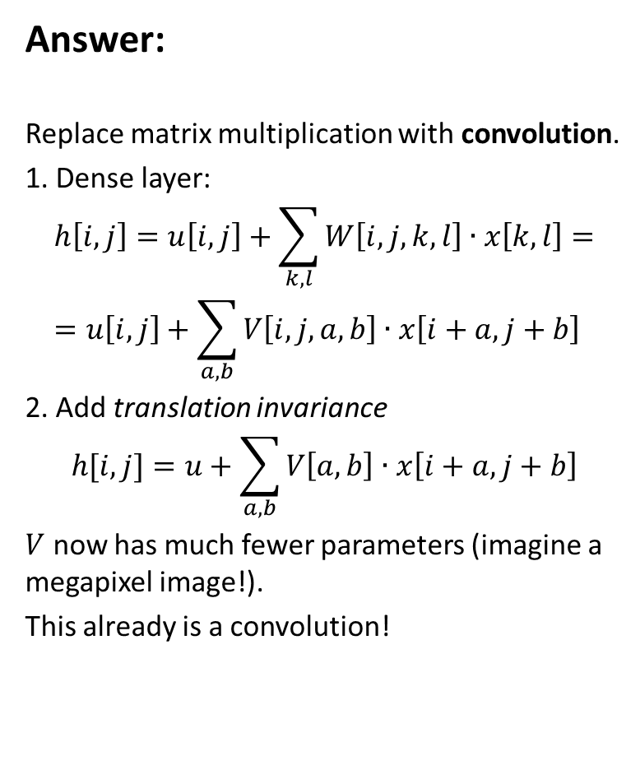
How to?
Answer:
Replace matrix multiplication with convolution.
1. Dense layer:
$$h\left[i,j\right]=u\left[i,j\right]+\sum_{k,l}{W\left[i,j,k,l\right]∙x\left[k,l\right]}= \\ =u\left[i,j\right]+\sum_{a,b}{V\left[i,j,a,b\right]∙x\left[i+a,j+b\right]}$$
2. Add translation invariance
$$h[i,j]=u+\sum_{a,b}{V\left[a,b\right]∙x\left[i+a,j+b\right]}$$
$V$ now has much fewer parameters (imagine a megapixel image!).
This already is a convolution!
extract local features
combine them into higher order features
make feature location irrelevant
preserve approximate information on position
Everything else stays the same:
Maximum likelihood
Back-propagation
Notes:
That’s for multilayer perceptron.

Slide 25
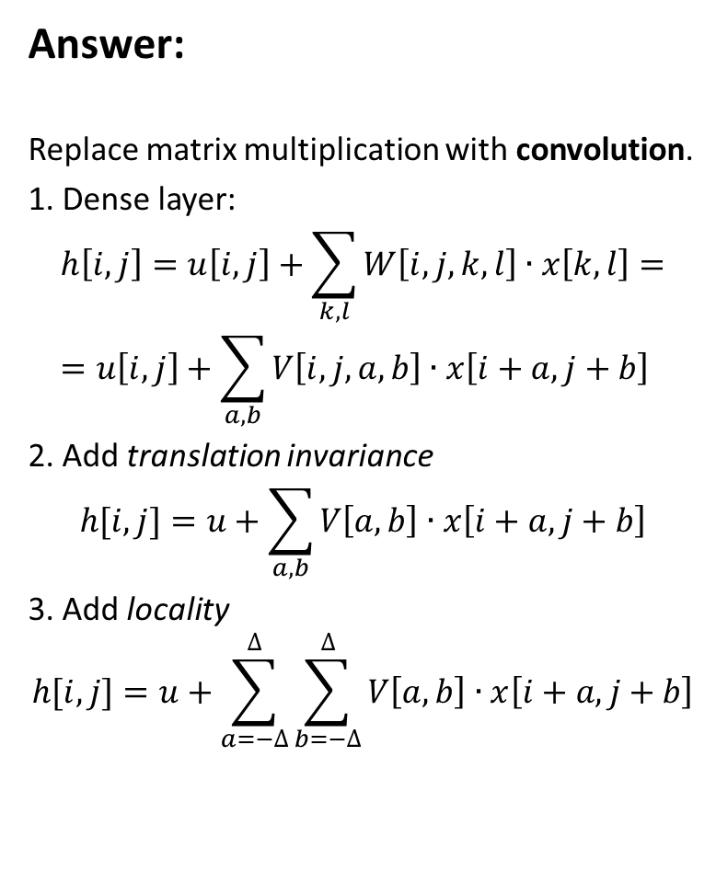
How to?
Answer:
Replace matrix multiplication with convolution.
1. Dense layer:
$$h\left[i,j\right]=u\left[i,j\right]+\sum_{k,l}{W\left[i,j,k,l\right]∙x\left[k,l\right]}= \\ =u\left[i,j\right]+\sum_{a,b}{V\left[i,j,a,b\right]∙x\left[i+a,j+b\right]}$$
2. Add translation invariance
$$h[i,j]=u+\sum_{a,b}{V\left[a,b\right]∙x\left[i+a,j+b\right]}$$
3. Add locality
$$h[i,j]=u+\sum_{a=−∆}^{∆}{\sum_{b=−∆}^{∆}{V\left[a,b\right]∙x\left[i+a,j+b\right]}}$$
extract local features
combine them into higher order features
make feature location irrelevant
preserve approximate information on position
Everything else stays the same:
Maximum likelihood
Back-propagation
Notes:
That’s for multilayer perceptron.

Slide 26
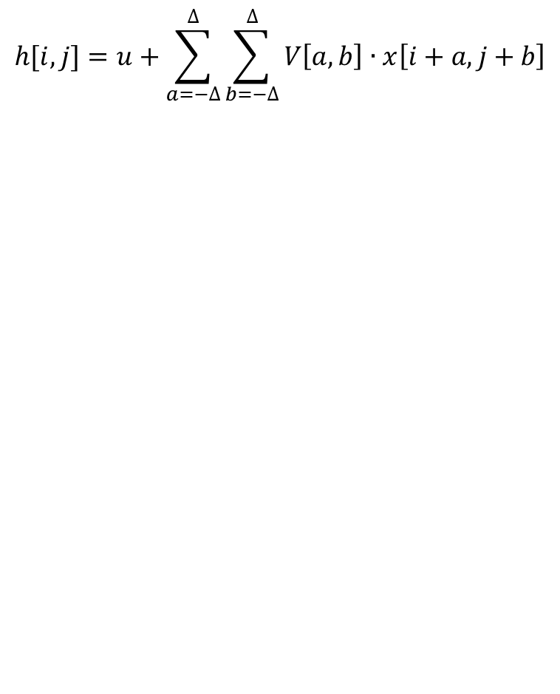
Convolution
$$h[i,j]=u+\sum_{a=−∆}^{∆}{\sum_{b=−∆}^{∆}{V\left[a,b\right]∙x\left[i+a,j+b\right]}}$$
extract local features
combine them into higher order features
make feature location irrelevant
preserve approximate information on position
Everything else stays the same:
Maximum likelihood
Back-propagation
Notes:
That’s for multilayer perceptron.

Slide 27
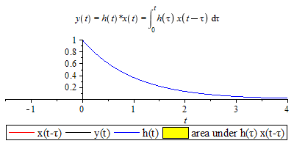
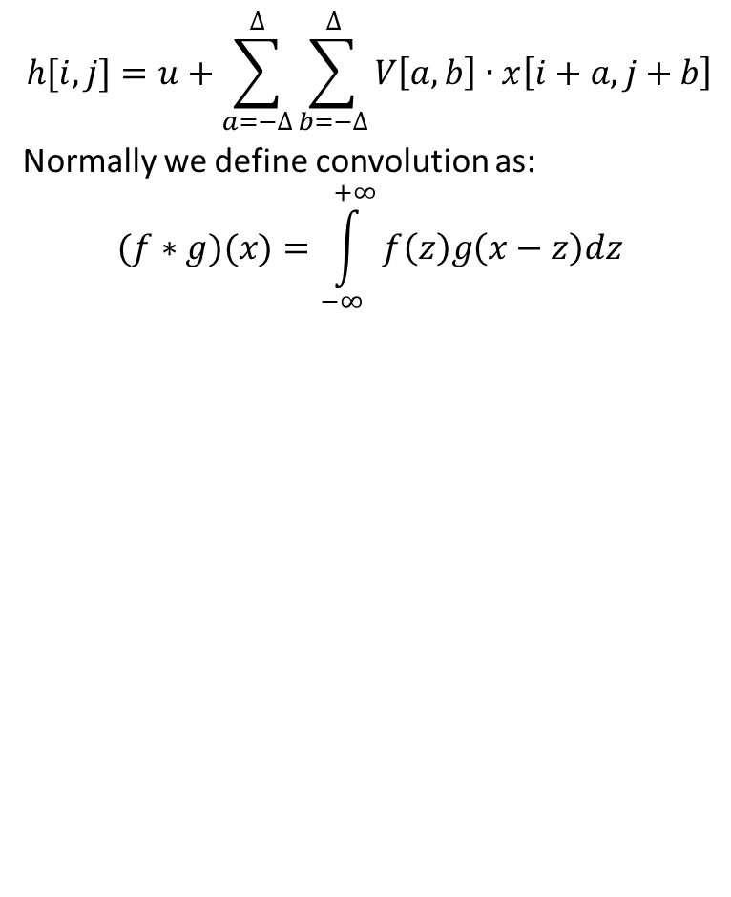
Convolution
$$h[i,j]=u+\sum_{a=−∆}^{∆}{\sum_{b=−∆}^{∆}{V\left[a,b\right]∙x\left[i+a,j+b\right]}}$$
Normally we define convolution as:
$$(f∗g)(x)=\int_{−∞}^{+∞}{f\left(z\right)g\left(x−z\right)dz}$$
extract local features
combine them into higher order features
make feature location irrelevant
preserve approximate information on position
Everything else stays the same:
Maximum likelihood
Back-propagation
Source: https://commons.wikimedia.org/wiki/File:Splot1.gif
Notes:
That’s for multilayer perceptron.

Slide 28
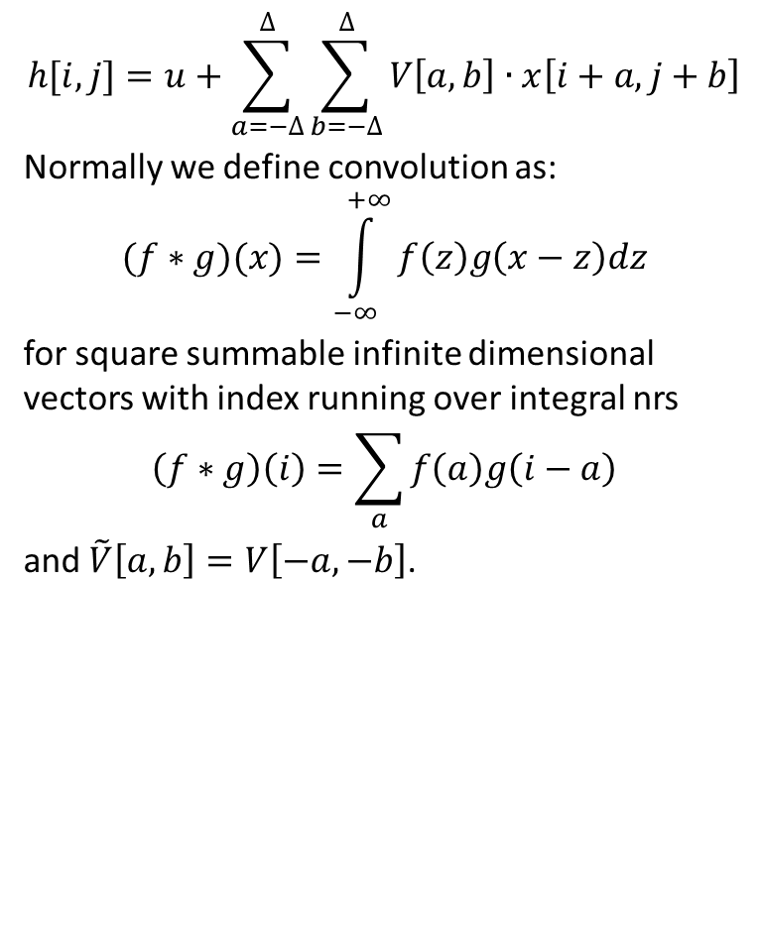
Convolution
$$h[i,j]=u+\sum_{a=−∆}^{∆}{\sum_{b=−∆}^{∆}{V\left[a,b\right]∙x\left[i+a,j+b\right]}}$$
Normally we define convolution as:
$$(f∗g)(x)=\int_{−∞}^{+∞}{f\left(z\right)g\left(x−z\right)dz}$$
for square summable infinite dimensional vectors with index running over integral nrs
$$\left(f∗g\right)\left(i\right)=\sum_{a}{f\left(a\right)g\left(i−a\right)}$$
and $\tilde{V}\left[a,b\right]=V\left[−a,−b\right]$.
extract local features
combine them into higher order features
make feature location irrelevant
preserve approximate information on position
Everything else stays the same:
Maximum likelihood
Back-propagation
Notes:
That’s for multilayer perceptron.

Slide 29
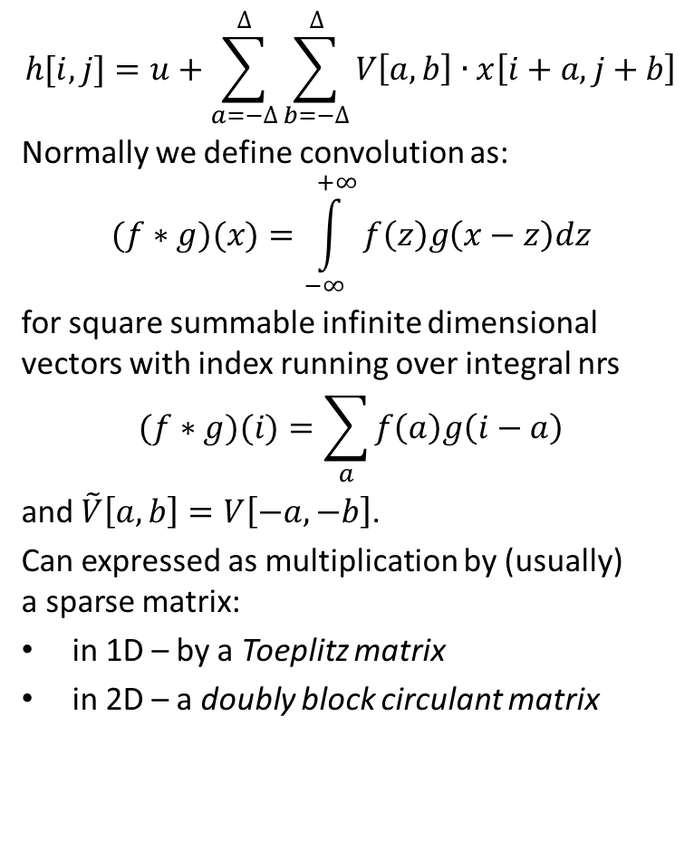
Convolution
$$h[i,j]=u+\sum_{a=−∆}^{∆}{\sum_{b=−∆}^{∆}{V\left[a,b\right]∙x\left[i+a,j+b\right]}}$$
Normally we define convolution as:
$$(f∗g)(x)=\int_{−∞}^{+∞}{f\left(z\right)g\left(x−z\right)dz}$$
for square summable infinite dimensional vectors with index running over integral nrs
$$(f∗g)(i)=\sum_{a}{f\left(a\right)g\left(i−a\right)}$$
and $\tilde{V}\left[a,b\right]=V\left[−a,−b\right]$.
Can expressed as multiplication by (usually) a sparse matrix:
in 1D – by a Toeplitz matrix
in 2D – a doubly block circulant matrix
extract local features
combine them into higher order features
make feature location irrelevant
preserve approximate information on position
Everything else stays the same:
Maximum likelihood
Back-propagation
Notes:
That’s for multilayer perceptron.

Slide 30

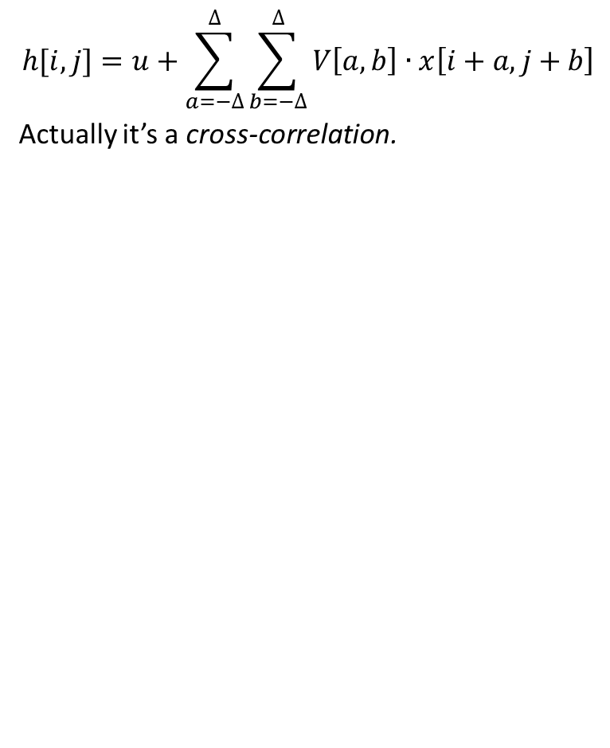
Convolution
$$h[i,j]=u+\sum_{a=−∆}^{∆}{\sum_{b=−∆}^{∆}{V\left[a,b\right]∙x\left[i+a,j+b\right]}}$$
Actually it’s a cross-correlation.
extract local features
combine them into higher order features
make feature location irrelevant
preserve approximate information on position
Everything else stays the same:
Maximum likelihood
Back-propagation
Source: https://github.com/vdumoulin/conv_arithmetic
Notes:
Convolution results in a smaller image!

Slide 31
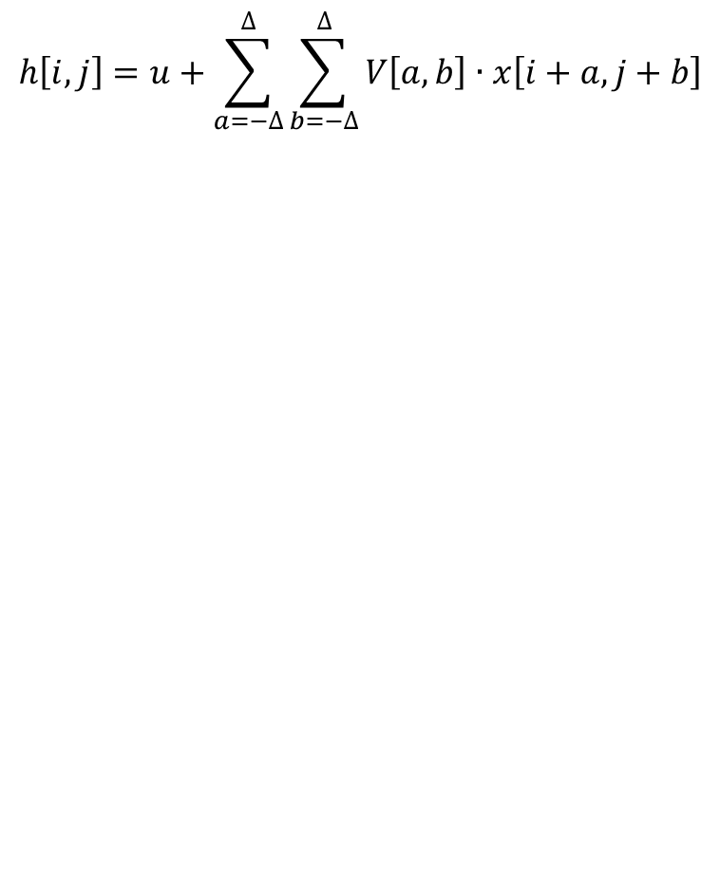
Why convolution?
$$h\left[i,j\right]=u+\sum_{a=−∆}^{∆}{\sum_{b=−∆}^{∆}{V\left[a,b\right]∙x\left[i+a,j+b\right]}}$$
extract local features
combine them into higher order features
make feature location irrelevant
preserve approximate information on position
Motivation:
sparse interactions/connectivity/weights
parameter sharing
equivariant representations
Notes:
That’s for multilayer perceptron.

Slide 32
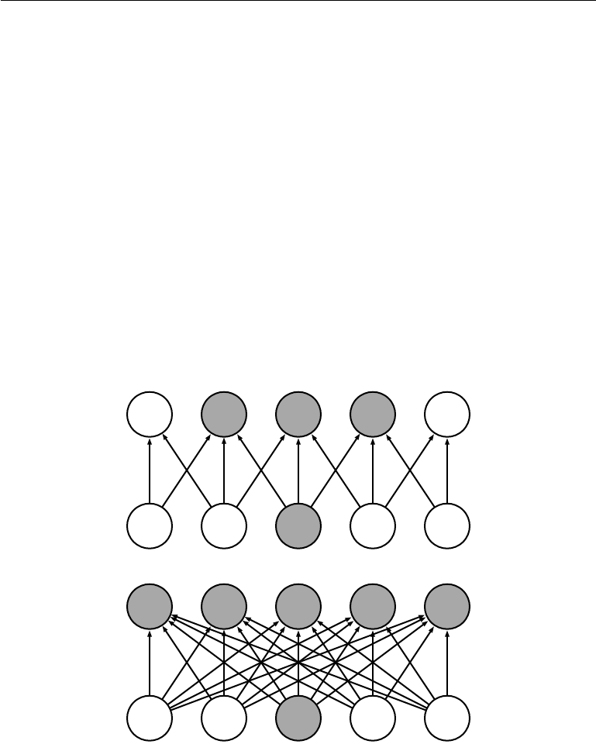
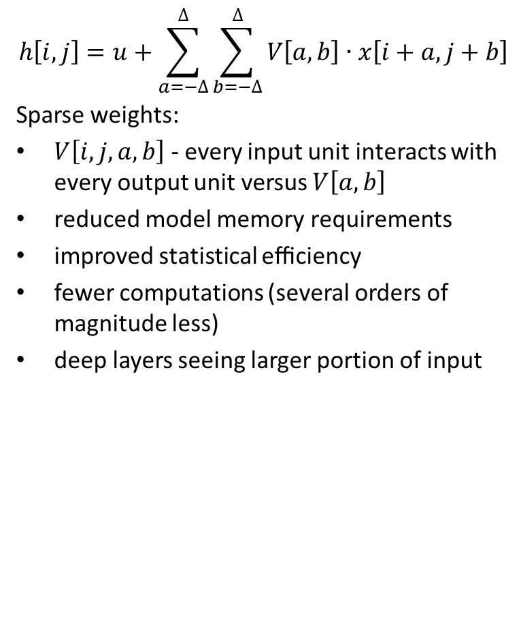
Why convolution?
$$h\left[i,j\right]=u+\sum_{a=−∆}^{∆}{\sum_{b=−∆}^{∆}{V\left[a,b\right]∙x\left[i+a,j+b\right]}}$$
Sparse weights:
$V\left[i,j,a,b\right]$ - every input unit interacts with every output unit versus $V\left[a,b\right]$
reduced model memory requirements
improved statistical eﬃciency
fewer computations (several orders of magnitude less)
deep layers seeing larger portion of input
extract local features
combine them into higher order features
make feature location irrelevant
preserve approximate information on position
Motivation:
sparse interactions/connectivity/weights
parameter sharing/tied weights
equivariant representations
Notes:
That’s for multilayer perceptron.

Slide 33
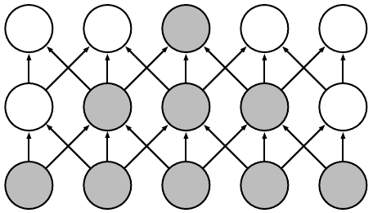
Why convolution?
$$h\left[i,j\right]=u+\sum_{a=−∆}^{∆}{\sum_{b=−∆}^{∆}{V\left[a,b\right]∙x\left[i+a,j+b\right]}}$$
Sparse weights:
$V\left[i,j,a,b\right]$ - every input unit interacts with every output unit versus $V\left[a,b\right]$
reduced model memory requirements
improved statistical eﬃciency
fewer computations (several orders of magnitude less)
deep layers seeing larger portion of input
extract local features
combine them into higher order features
make feature location irrelevant
preserve approximate information on position
Motivation:
sparse interactions/connectivity/weights
parameter sharing/tied weights
equivariant representations
Notes:
Receptive field.

Slide 34
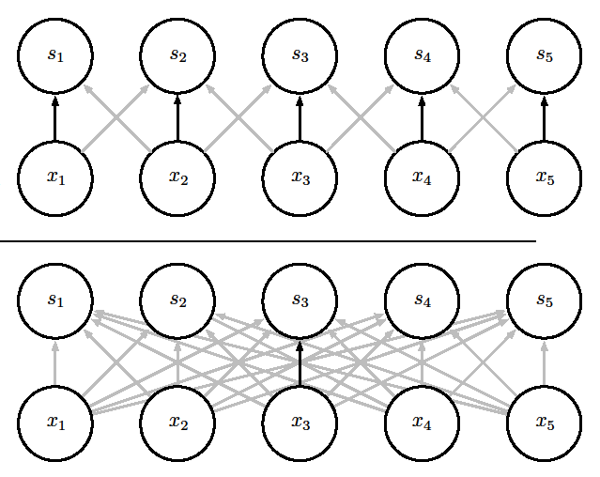
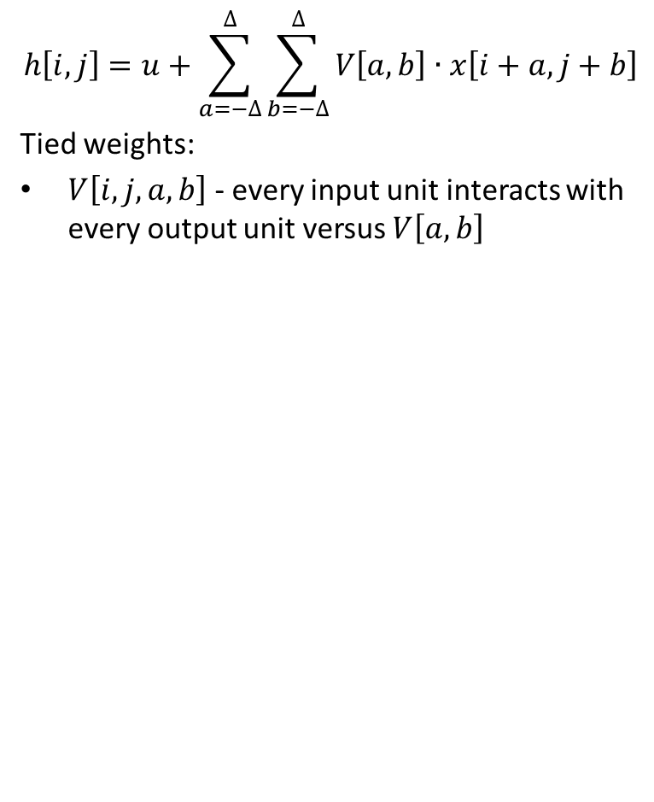
Why convolution?
$$h\left[i,j\right]=u+\sum_{a=−∆}^{∆}{\sum_{b=−∆}^{∆}{V\left[a,b\right]∙x\left[i+a,j+b\right]}}$$
Tied weights:
$V\left[i,j,a,b\right]$ - every input unit interacts with every output unit versus $V\left[a,b\right]$
extract local features
combine them into higher order features
make feature location irrelevant
preserve approximate information on position
Motivation:
sparse interactions/connectivity/weights
parameter sharing/tied weights
equivariant representations
Notes:
Receptive field.

Slide 35
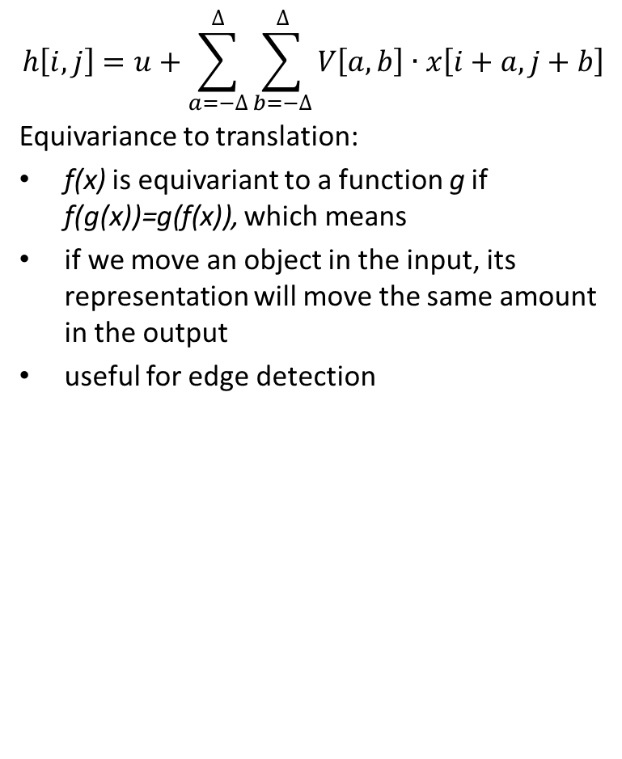
Why convolution?
$$h\left[i,j\right]=u+\sum_{a=−∆}^{∆}{\sum_{b=−∆}^{∆}{V\left[a,b\right]∙x\left[i+a,j+b\right]}}$$
Equivariance to translation:
f(x) is equivariant to a function g if f(g(x))=g(f(x)), which means
if we move an object in the input, its representation will move the same amount in the output
useful for edge detection
extract local features
combine them into higher order features
make feature location irrelevant
preserve approximate information on position
Motivation:
sparse interactions/connectivity/weights
parameter sharing/tied weights
equivariant representations
Notes:
Receptive field.

Slide 36
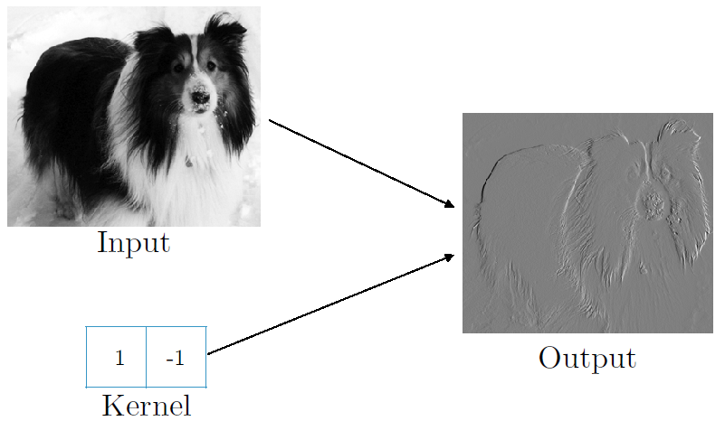
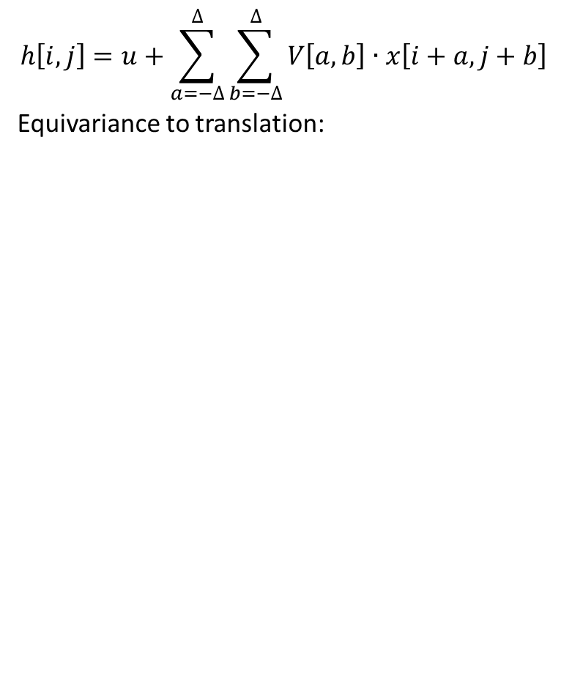
Why convolution?
$$h\left[i,j\right]=u+\sum_{a=−∆}^{∆}{\sum_{b=−∆}^{∆}{V\left[a,b\right]∙x\left[i+a,j+b\right]}}$$
Equivariance to translation:
extract local features
combine them into higher order features
make feature location irrelevant
preserve approximate information on position
Motivation:
sparse interactions/connectivity/weights
parameter sharing/tied weights
equivariant representations
Notes:
Receptive field.

Slide 37
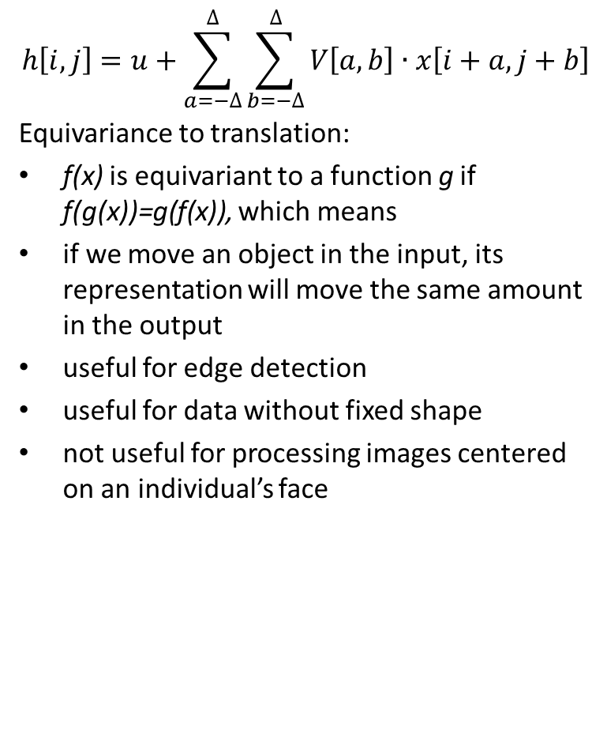
Why convolution?
$$h\left[i,j\right]=u+\sum_{a=−∆}^{∆}{\sum_{b=−∆}^{∆}{V\left[a,b\right]∙x\left[i+a,j+b\right]}}$$
Equivariance to translation:
f(x) is equivariant to a function g if f(g(x))=g(f(x)), which means
if we move an object in the input, its representation will move the same amount in the output
useful for edge detection
useful for data without fixed shape
not useful for processing images centered on an individual’s face
extract local features
combine them into higher order features
make feature location irrelevant
preserve approximate information on position
Motivation:
sparse interactions/connectivity/weights
parameter sharing/tied weights
equivariant representations
Notes:
Receptive field.

Slide 38
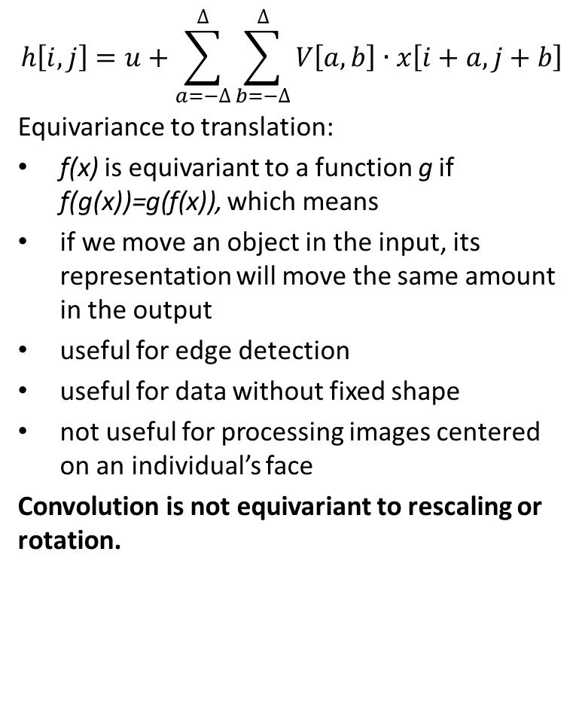
Why convolution?
$$h\left[i,j\right]=u+\sum_{a=−∆}^{∆}{\sum_{b=−∆}^{∆}{V\left[a,b\right]∙x\left[i+a,j+b\right]}}$$
Equivariance to translation:
f(x) is equivariant to a function g if f(g(x))=g(f(x)), which means
if we move an object in the input, its representation will move the same amount in the output
useful for edge detection
useful for data without fixed shape
not useful for processing images centered on an individual’s face
Convolution is not equivariant to rescaling or rotation.
extract local features
combine them into higher order features
make feature location irrelevant
preserve approximate information on position
Motivation:
sparse interactions/connectivity/weights
parameter sharing/tied weights
equivariant representations
Notes:
Receptive field.

Slide 39
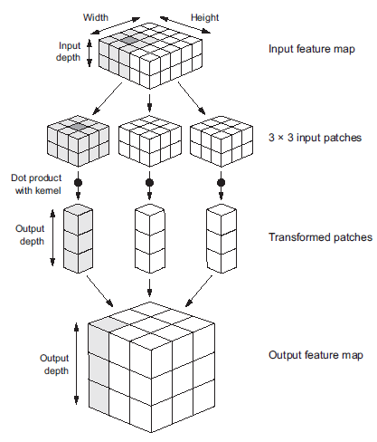


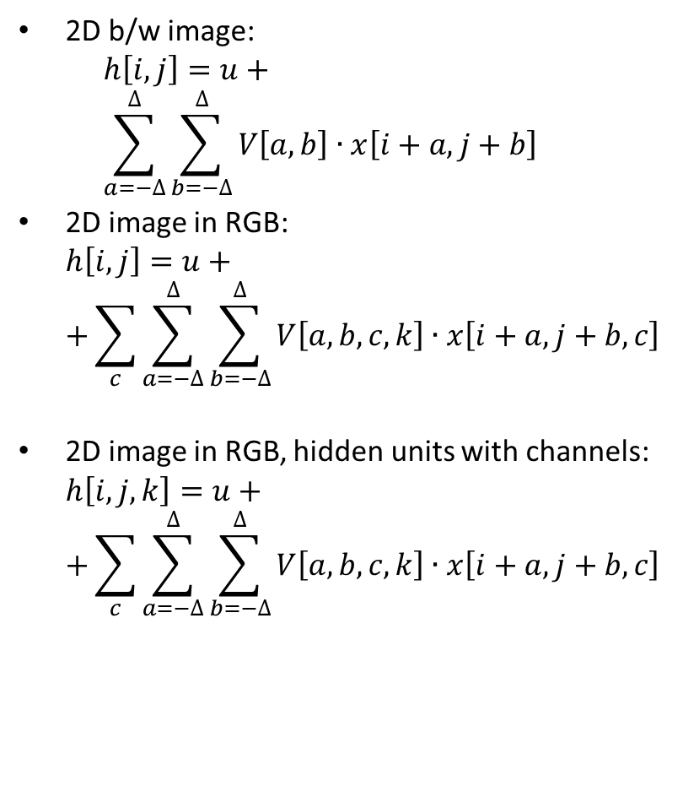
Images
2D b/w image: $h\left[i,j\right]=u+$ $\sum_{a=−∆}^{∆}{\sum_{b=−∆}^{∆}{V\left[a,b\right]∙x\left[i+a,j+b\right]}}$
2D image in RGB: $h\left[i,j\right]=u+$ $+\sum_{c}{\sum_{a=−∆}^{∆}{\sum_{b=−∆}^{∆}{V\left[a,b,c,k\right]∙x\left[i+a,j+b,c\right]}}}$
2D image in RGB, hidden units with channels: $h\left[i,j,k\right]=u+$ $+\sum_{c}{\sum_{a=−∆}^{∆}{\sum_{b=−∆}^{∆}{V\left[a,b,c,k\right]∙x\left[i+a,j+b,c\right]}}}$
extract local features
combine them into higher order features
make feature location irrelevant
preserve approximate information on position
Motivation:
sparse interactions/connectivity/weights
parameter sharing/tied weights
equivariant representations
Notes:
Think of hidden depth as result of different filters

Slide 40
Images
 | Single channel | Multichannel
1D | Audio waveform | Skeleton animation data: at each moment, the pose is described by the angles of each of the joints
2D | Fourier transform of audio: equivariant to shifts in time and/or equivariant to change of frequency | Color image data
3D | Volumetric data: CT scans, etc. | Color video data
extract local features
combine them into higher order features
make feature location irrelevant
preserve approximate information on position
Notes:
Receptive field.

Slide 41
Images
extract local features
combine them into higher order features
make feature location irrelevant
preserve approximate information on position
Source: https://sites.google.com/site/5kk73gpu2013/assignment/cnn
Notes:
Receptive field.

Slide 42
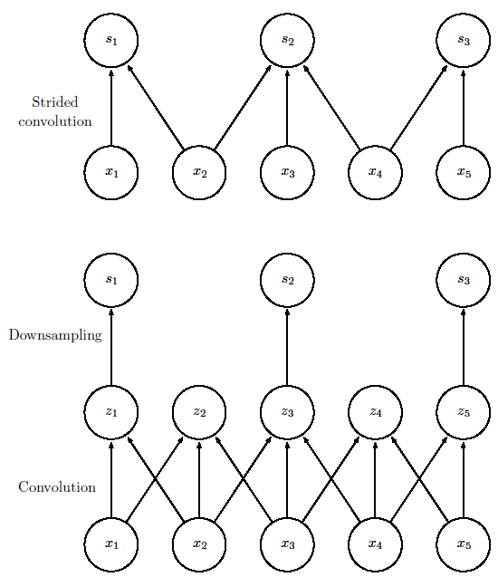
Downsampling
extract local features
combine them into higher order features
make feature location irrelevant
preserve approximate information on position
Motivation:
sparse interactions/connectivity/weights
parameter sharing/tied weights
equivariant representations
Notes:
Receptive field.

Slide 43
Downsampling
extract local features
combine them into higher order features
make feature location irrelevant
preserve approximate information on position
Motivation:
sparse interactions/connectivity/weights
parameter sharing/tied weights
equivariant representations
WASTEFUL
Notes:
Receptive field.

Slide 44


Downsampling
extract local features
combine them into higher order features
make feature location irrelevant
preserve approximate information on position
Motivation:
sparse interactions/connectivity/weights
parameter sharing/tied weights
equivariant representations
Source: https://github.com/vdumoulin/conv_arithmetic
Notes:
Receptive field.

Slide 45
Pooling
extract local features
combine them into higher order features
make feature location irrelevant
preserve approximate information on position
Source: https://sites.google.com/site/5kk73gpu2013/assignment/cnn
Notes:
Receptive field.

Slide 46

Pooling
reduce spatial size of the features
extract dominant features which are rotational and positional invariant
suppresses noise
extract local features
combine them into higher order features
make feature location irrelevant
preserve approximate information on position
Source: https://towardsdatascience.com/
Notes:
Receptive field.

Slide 47
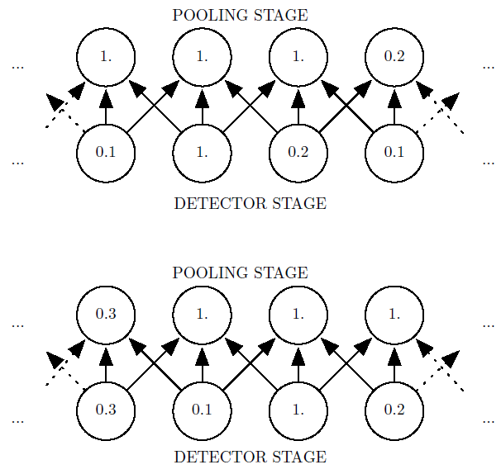
Pooling
pooling over spatial regions produces invariance to translation
extract local features
combine them into higher order features
make feature location irrelevant
preserve approximate information on position
Notes:
Receptive field.

Slide 48
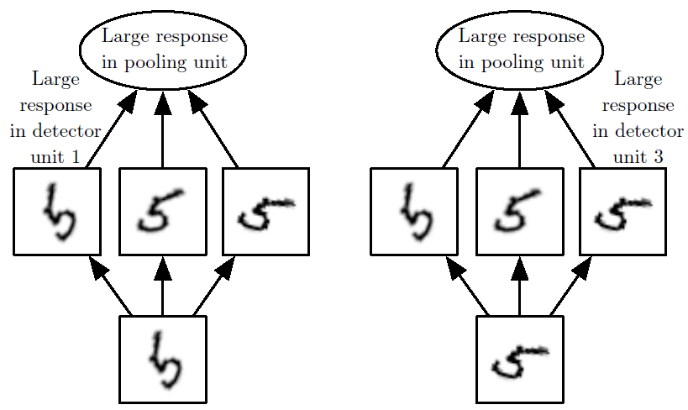
Pooling
pooling over spatial regions produces invariance to translation
if we pool over the outputs of separately parametrized convolutions, the features can learn which transformations to become invariant to
extract local features
combine them into higher order features
make feature location irrelevant
preserve approximate information on position
Notes:
Receptive field.

Slide 49
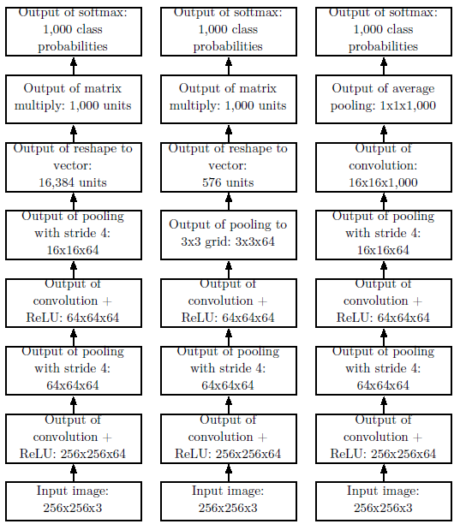
Pooling
Final pooling layer of the network may be used to resize output for classification irrespective of the input image size.
extract local features
combine them into higher order features
make feature location irrelevant
preserve approximate information on position
Notes:
Receptive field.

Slide 50
Pooling
Pooling can be considered as an inﬁnitely strong prior over network weights.
Consequences:
can cause underﬁtting (are assumptions made by the prior accurate)
do not compare CNNs to permutation invariant models
extract local features
combine them into higher order features
make feature location irrelevant
preserve approximate information on position
Notes:
If a task relies on preserving precise spatial
information, then using pooling on all features can increase the training error.
Some convolutional network architectures (Szegedy et al., 2014a) are designed to
use pooling on some channels but not on other channels, in order to get both
highly invariant features and features that will not underﬁt when the translation
invariance prior is incorrect. When a task involves incorporating information from
very distant locations in the input, then the prior imposed by convolution may be
inappropriate.

Slide 51
Backpropagation?
Convolution as a matrix operation:
Source: https://github.com/vdumoulin/conv_arithmetic
Notes:
filter/feature = kernel
feature map = convolution (of a given kernel)

Slide 52
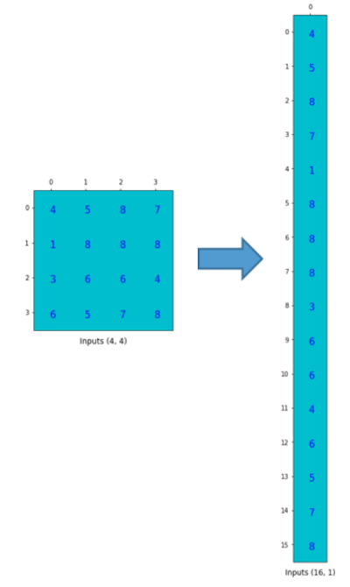
Backpropagation?
Convolution as a matrix operation:
vectorise the input (reshape from 4x4 to 16) and output (from 2x2 to 4)
Source: https://medium.com/activating-robotic-minds/up-sampling-with-transposed-convolution-9ae4f2df52d0
Notes:
filter/feature = kernel
feature map = convolution (of a given kernel)

Slide 53
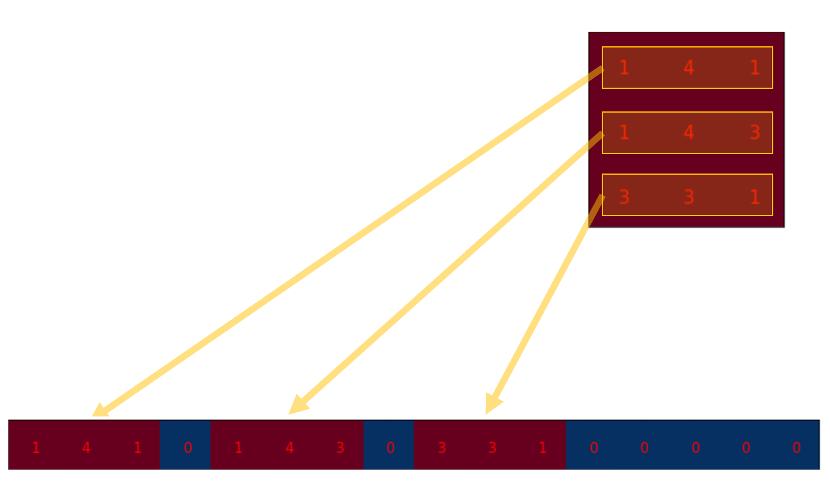
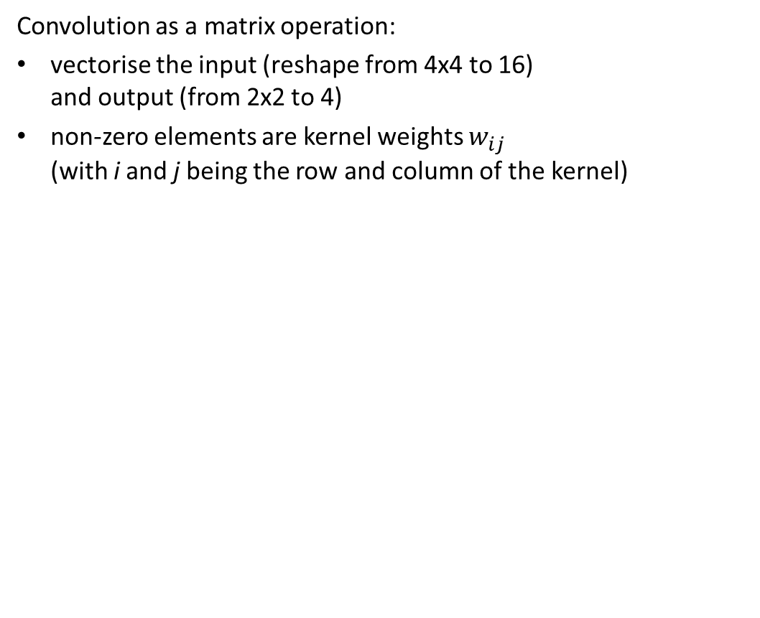
Backpropagation?
Convolution as a matrix operation:
vectorise the input (reshape from 4x4 to 16) and output (from 2x2 to 4)
non-zero elements are kernel weights $w_{ij}$ (with i and j being the row and column of the kernel)
Source: https://medium.com/activating-robotic-minds/up-sampling-with-transposed-convolution-9ae4f2df52d0
Notes:
filter/feature = kernel
feature map = convolution (of a given kernel)

Slide 54
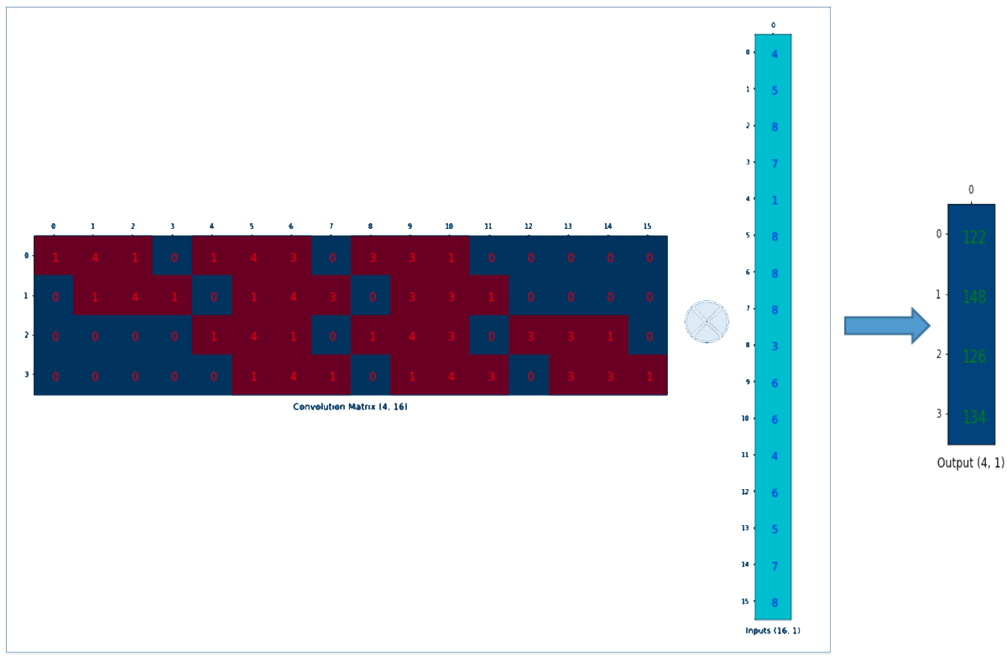
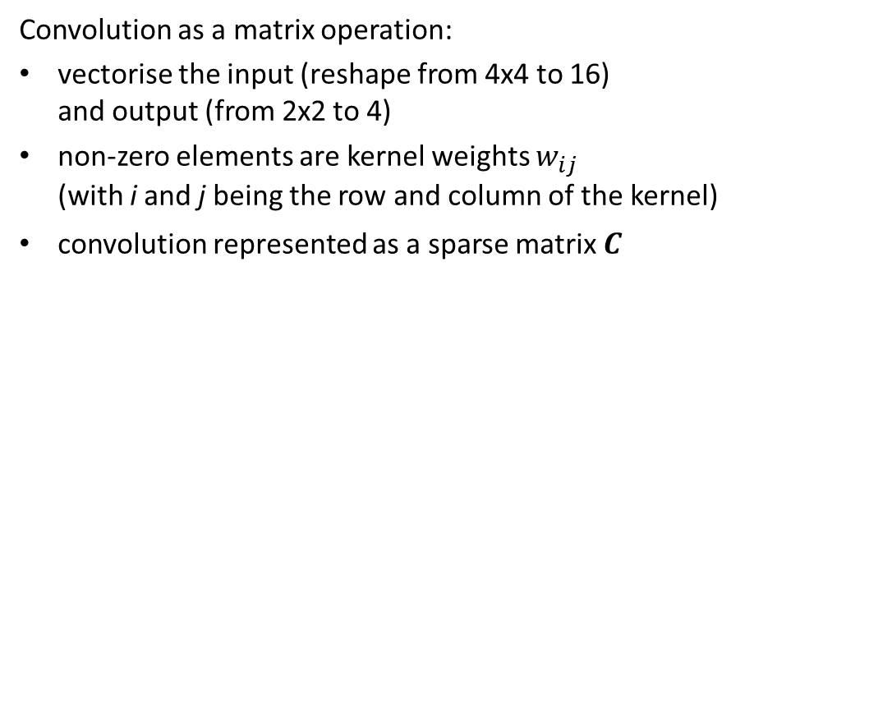
Backpropagation?
Convolution as a matrix operation:
vectorise the input (reshape from 4x4 to 16) and output (from 2x2 to 4)
non-zero elements are kernel weights $w_{ij}$ (with i and j being the row and column of the kernel)
convolution represented as a sparse matrix $C^{}$
Source: https://medium.com/activating-robotic-minds/up-sampling-with-transposed-convolution-9ae4f2df52d0
Notes:
filter/feature = kernel
feature map = convolution (of a given kernel)

Slide 55
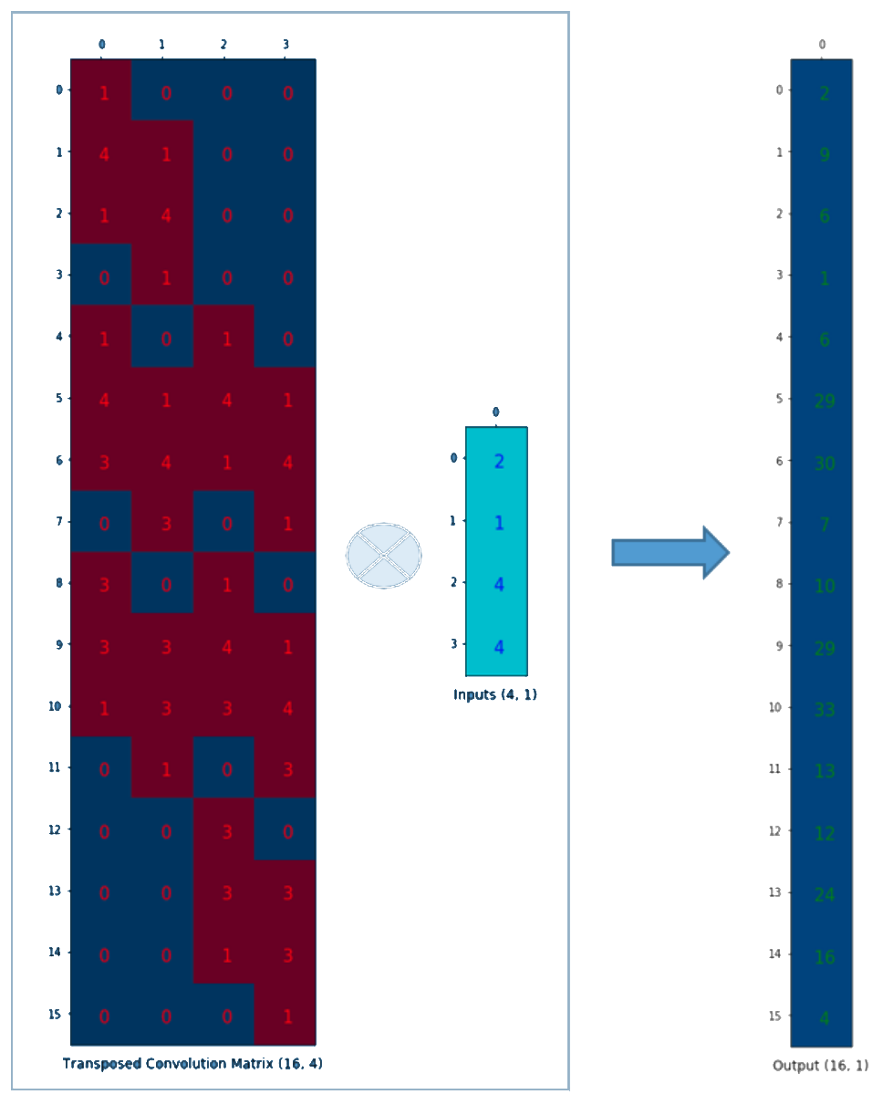
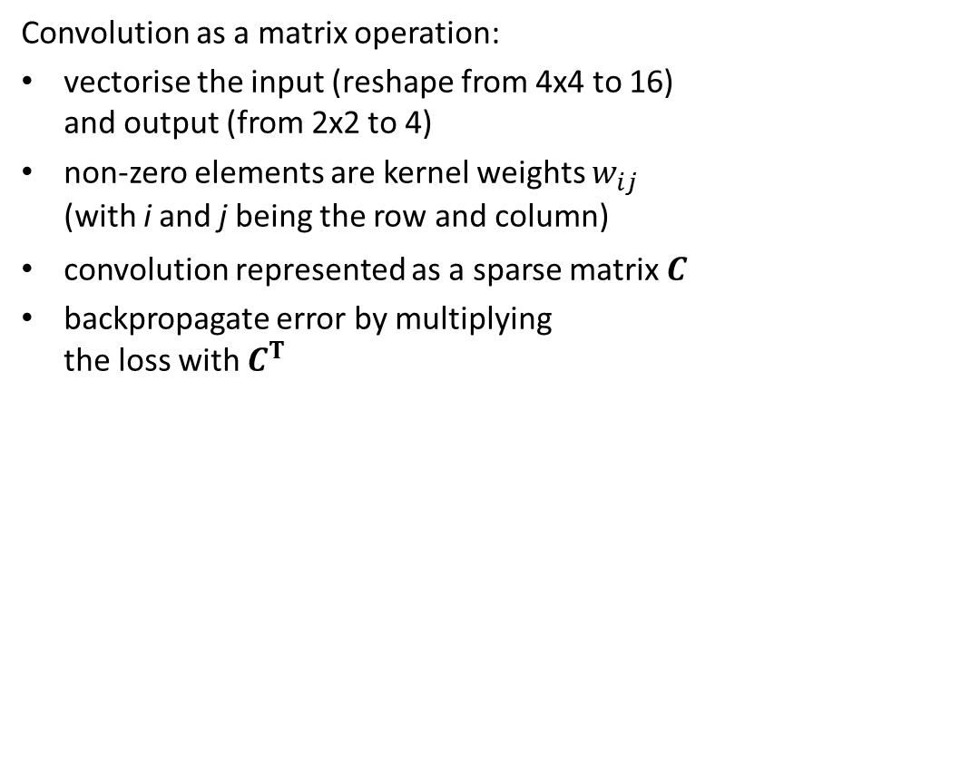
Backpropagation?
Convolution as a matrix operation:
vectorise the input (reshape from 4x4 to 16) and output (from 2x2 to 4)
non-zero elements are kernel weights $w_{ij}$ (with i and j being the row and column)
convolution represented as a sparse matrix $C^{}$
backpropagate error by multiplying the loss with $C^{T}$
Source: https://medium.com/activating-robotic-minds/up-sampling-with-transposed-convolution-9ae4f2df52d0

Slide 56
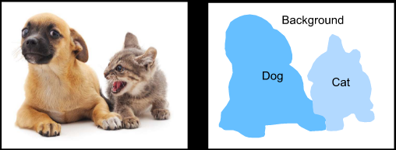
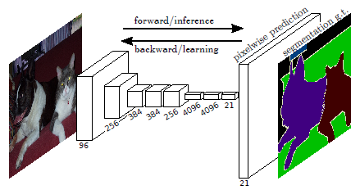
Transposed convolution
The layers introduced so far for CNNs (convolutional layers and pooling layers) often reduce the input width and height, or keep them unchanged.
Applications such as:
semantic segmentation
generative adversarial networks
require to predict values for each pixel
Source: d2l.ai
Source: https://people.eecs.berkeley.edu/~jonlong/long_shelhamer_fcn.pdf

Slide 57
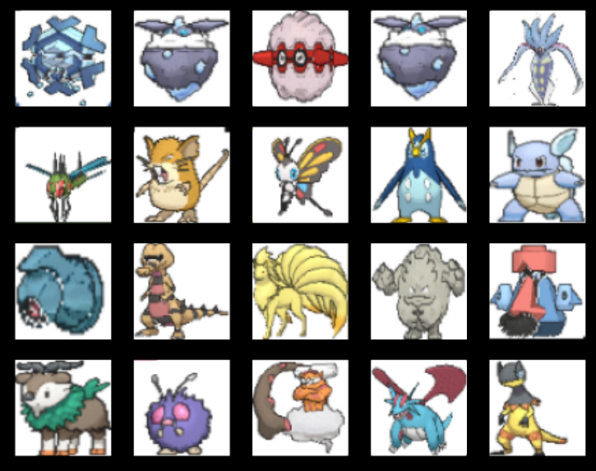
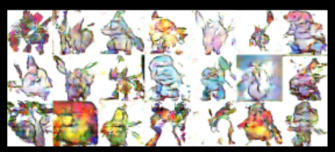
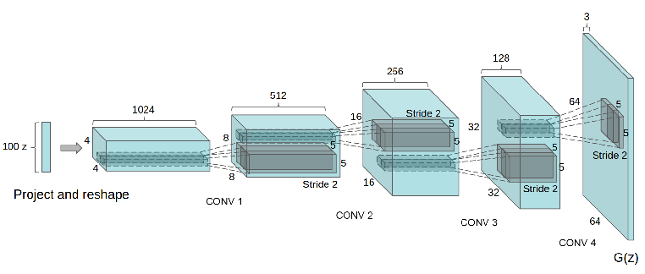
Transposed convolution
The layers introduced so far for CNNs (convolutional layers and pooling layers) often reduce the input width and height, or keep them unchanged.
Applications such as:
semantic segmentation
generative adversarial networks
require to predict values for each pixel
Source: d2l.ai
Source: https://arxiv.org/pdf/1511.06434v2.pdf

Slide 58
Transposed convolution
The layers introduced so far for CNNs (convolutional layers and pooling layers) often reduce the input width and height, or keep them unchanged.
Applications such as:
semantic segmentation
generative adversarial networks
require to predict values for each pixel
We need to up-scale!

Slide 59
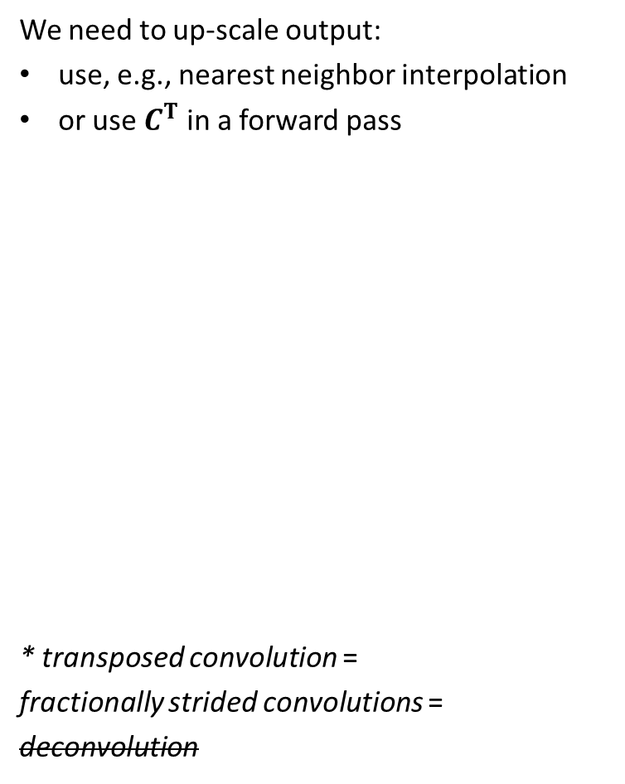
Transposed convolution*
We need to up-scale output:
use, e.g., nearest neighbor interpolation
or use $C^{T}$ in a forward pass
* transposed convolution =
fractionally strided convolutions =
deconvolution

Slide 60
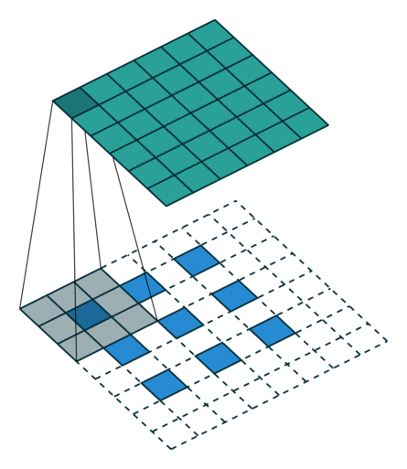

Transposed convolution*
We need to up-scale output:
use, e.g., nearest neighbor interpolation
or use $C^{T}$ in a forward pass
* transposed convolution =
fractionally strided convolutions =
deconvolution

Slide 61
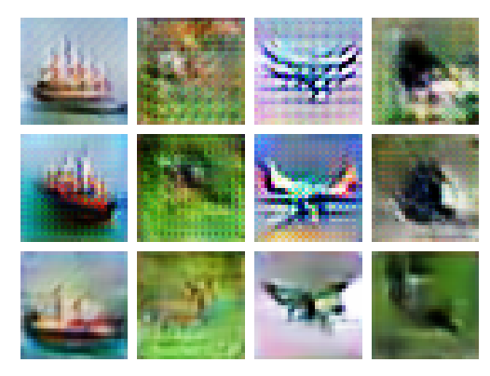
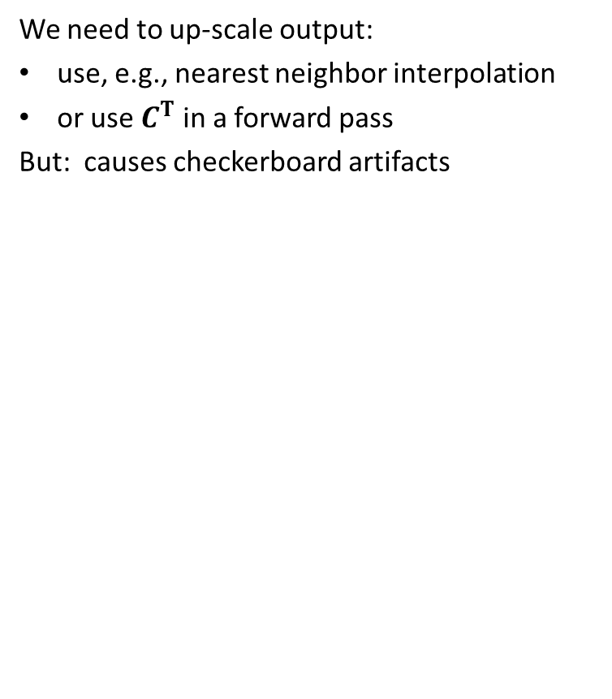
Transposed convolution*
We need to up-scale output:
use, e.g., nearest neighbor interpolation
or use $C^{T}$ in a forward pass
But: causes checkerboard artifacts
Source: https://distill.pub/2016/deconv-checkerboard/

Slide 62

Success story
a convolutional network developed by AT&T for reading checks (LeCun et al., 1998b)
OCR and handwriting recognition systems
ImageNet object recognition challenge (Krizhevsky et al. 2012)
Notes:
With modern hardware, large fully connected networks appear to perform reasonably on many tasks

Slide 63

Success story
a convolutional network developed by AT&T for reading checks (LeCun et al., 1998b)
OCR and handwriting recognition systems
ImageNet object recognition challenge (Krizhevsky et al. 2012)
Notes:
With modern hardware, large fully connected networks appear to perform reasonably on many tasks

Slide 64
Success story
Convnets more computationally eﬃcient than fully connected networks
specialized to work with data that has a clear grid-structured topology
easier to run multiple experiments and tune their implementation and hyperparameters
easier to train larger networks
most successful on a two-dimensional image topology
a convolutional network developed by AT&T for reading checks (LeCun et al., 1998b)
OCR and handwriting recognition systems
ImageNet object recognition challenge (Krizhevsky et al. 2012)
Notes:
With modern hardware, large fully connected networks appear to perform reasonably on many tasks

Slide 65
Success story
Convnets more computationally eﬃcient than fully connected networks
specialized to work with data that has a clear grid-structured topology
easier to run multiple experiments and tune their implementation and hyperparameters
easier to train larger networks
most successful on a two-dimensional image topology
a convolutional network developed by AT&T for reading checks (LeCun et al., 1998b)
OCR and handwriting recognition systems
ImageNet object recognition challenge (Krizhevsky et al. 2012)
Some well-known architectures:
LeNet
AlexNet
VGGNet
GoogLeNet
ResNet
ZFNet
…
Notes:
With modern hardware, large fully connected networks appear to perform reasonably on many tasks

Slide 66
Success story
What about training cost?
Strategies for initialisation :
randomly
by hand
apply unsupervised clustering to small image patches, then use each learned prototypes as convolution kernels
Can be determined separately from the classiﬁer layer. Extracted for the entire training set just once.
a convolutional network developed by AT&T for reading checks (LeCun et al., 1998b)
OCR and handwriting recognition systems
ImageNet object recognition challenge (Krizhevsky et al. 2012)
Some well-known architectures:
LeNet
AlexNet
VGGNet
GoogLeNet
ResNet
ZFNet
…
Notes:
it is possible to use unsupervised learning to train a convolutional network without ever using convolution during the training

